Slide 1
Created by: computer section
Presented by : snehal patil
Subject : cyber crime

Slide 2
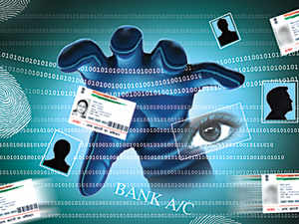
CYBER CRIME AND CYBER LAW

Slide 4
X
TYPES OF CYBER CRIME

Slide 7
Virus attack

Slide 9
CYBER THEFT
CYBER THEFT

Slide 10
SOFTWARE PIRACY
SOFTWARE PIRACY

Slide 12
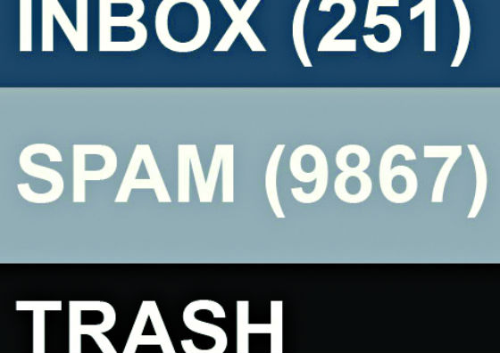
EMAIL BOMBS.
EMAIL BOMBS

Slide 17
PISHING
PISHING

Slide 18
CREDIT CARD FRAUD.
CREDIT CARD FRAUD

Slide 20
WHAT IS CYBER LAWS ?

